Slide 1
NML ONLINE SOFTWARE
SERVICE DIVISION
Department of Information Technology

Slide 2
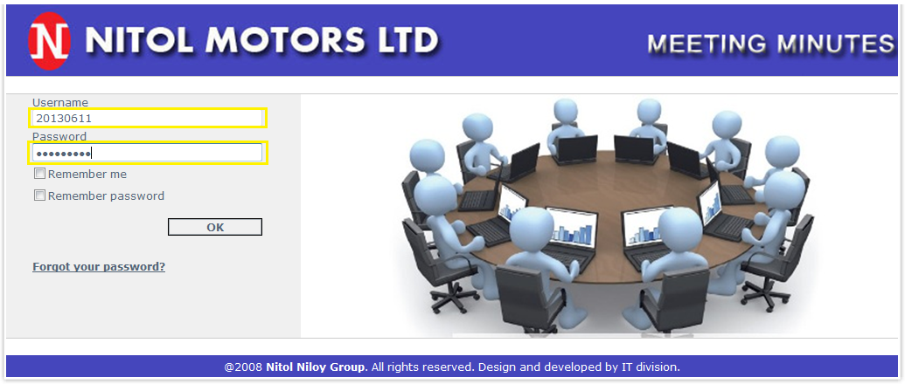
Login Page

Slide 3
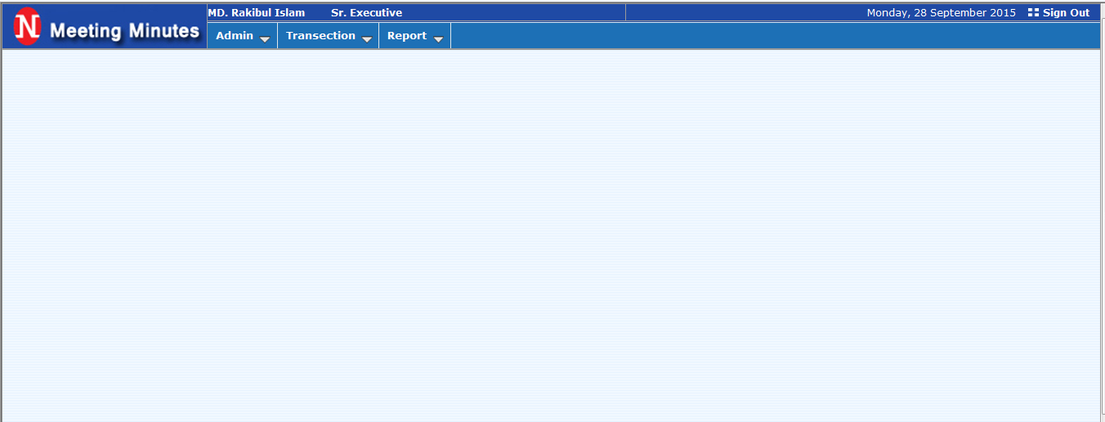
1.Home Page

Slide 4
2.Transactions
A. Transactions : –> Meeting(Entry)

Slide 5
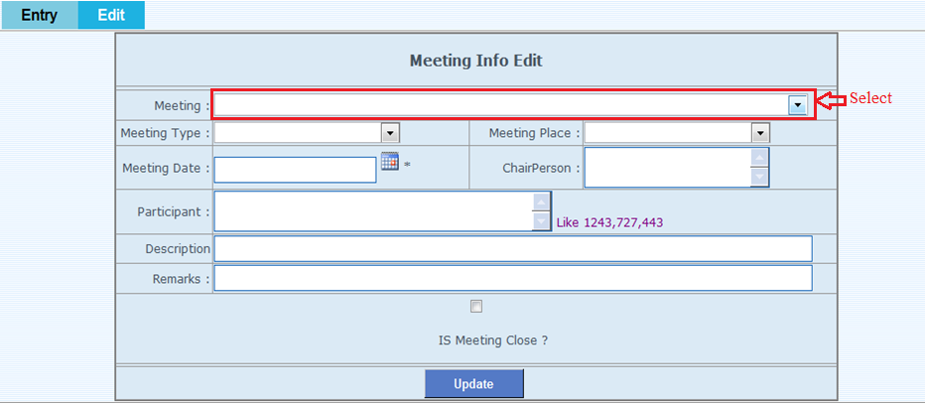
2.Transactions
A. Transactions : –> Meeting(Edit-1)

Slide 6
2.Transactions
A. Transactions : –> Meeting(Edit-2)

Slide 7
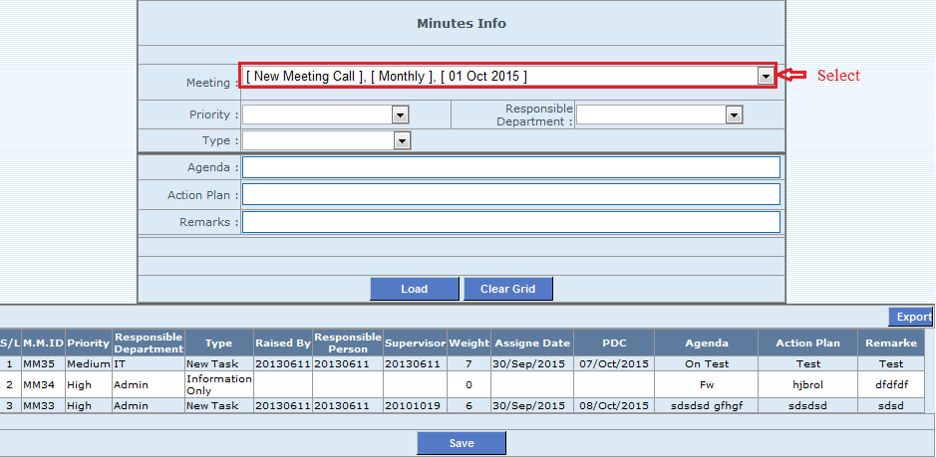
2.Transactions
A. Transactions : –> Minutes(Entry-1)

Slide 8
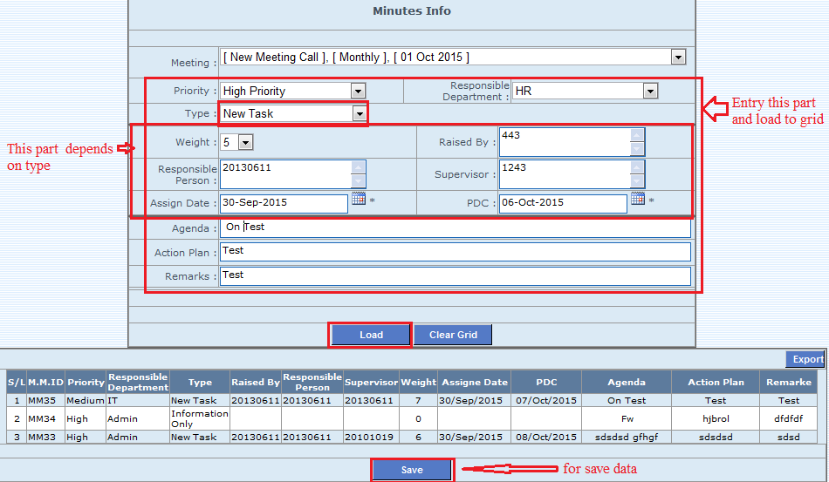
2.Transactions
A. Transactions : –> Minutes(Entry-2)

Slide 9
2.Transactions
A. Transactions : –> Minutes(Edit-1)

Slide 10
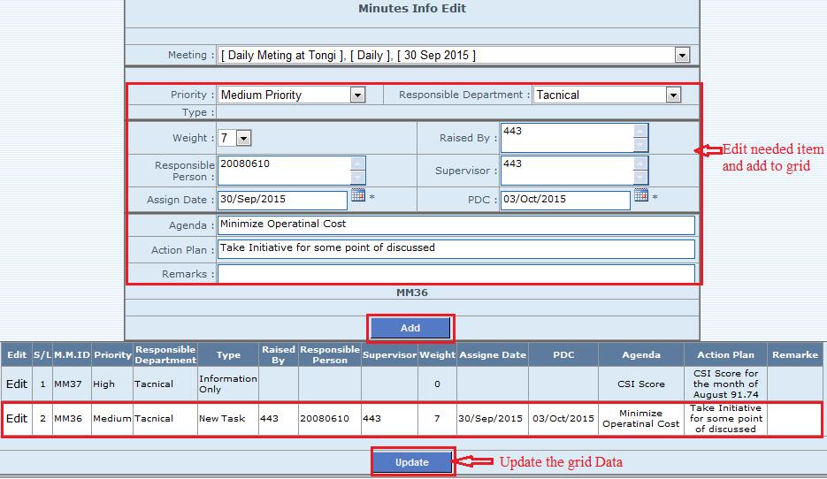
2.Transactions
A. Transactions : –> Minutes(Edit-2)

Slide 11
2.Transactions
A. Transactions : –> Minutes Feedback & Follow Up(Feedback-1)

Slide 12
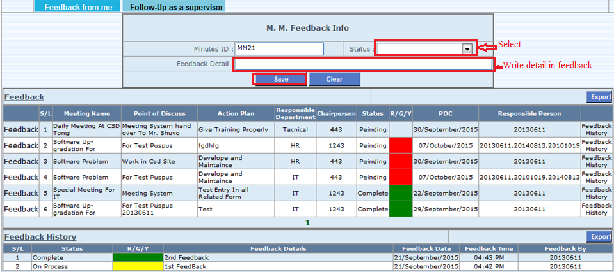
2.Transactions
A. Transactions : –> Minutes Feedback & Follow Up(Feedback-2)

Slide 13
2.Transactions
A. Transactions : –> Minutes Feedback & Follow Up(Follow Up-1)

Slide 14
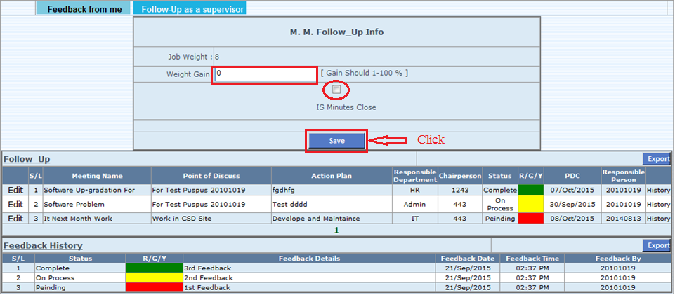
2.Transactions
A. Transactions : –> Minutes Feedback & Follow Up(Follow Up-2)

Slide 15
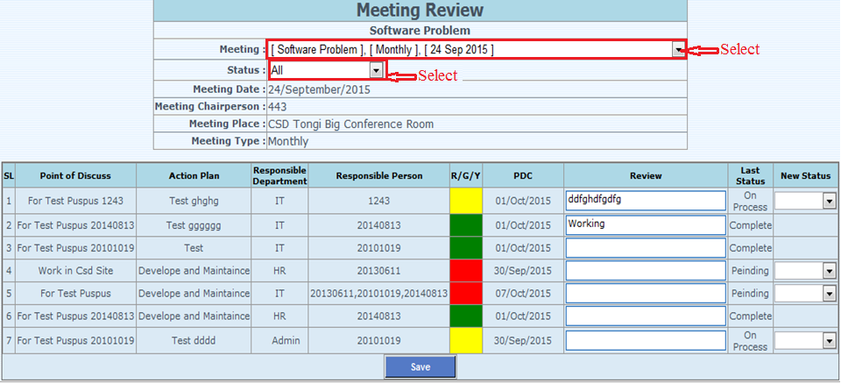
2.Transactions
A. Transactions : –> Review->Meeting Wise-1

Slide 16
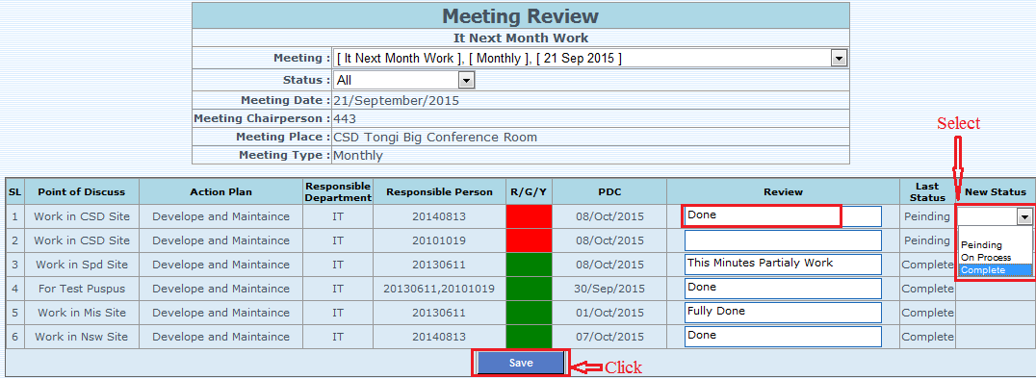
2.Transactions
A. Transactions : –> Review->Meeting Wise-2

Slide 17
2.Transactions
A. Transactions : –> Review->Date Wise

Slide 18
3.Report
B. Report : –> View-1

Slide 19
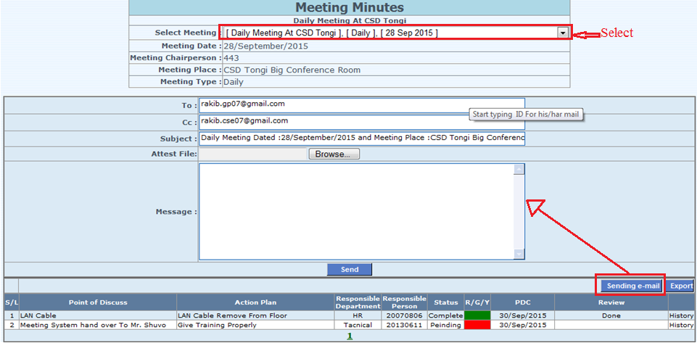
3.Report
B. Report : –> View-2

Slide 20
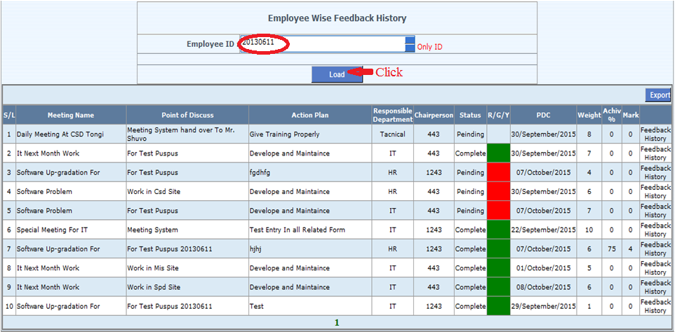
3.Report
B. Report : –> Employee Wise History-1

Slide 21
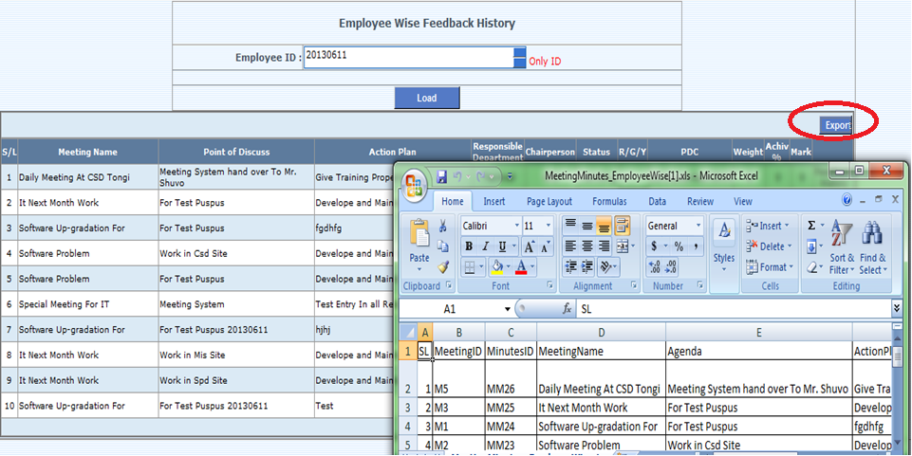
3.Report
B. Report : –> Employee Wise History-2

Slide 22
4. Change Password
C. Admin : –> Change Password

Slide 23
5. In Future Task…
* Developed for all Service Center
* Developed with Memo System
* Minutes Summery Report

Slide 24
Thank You

